Slide 1
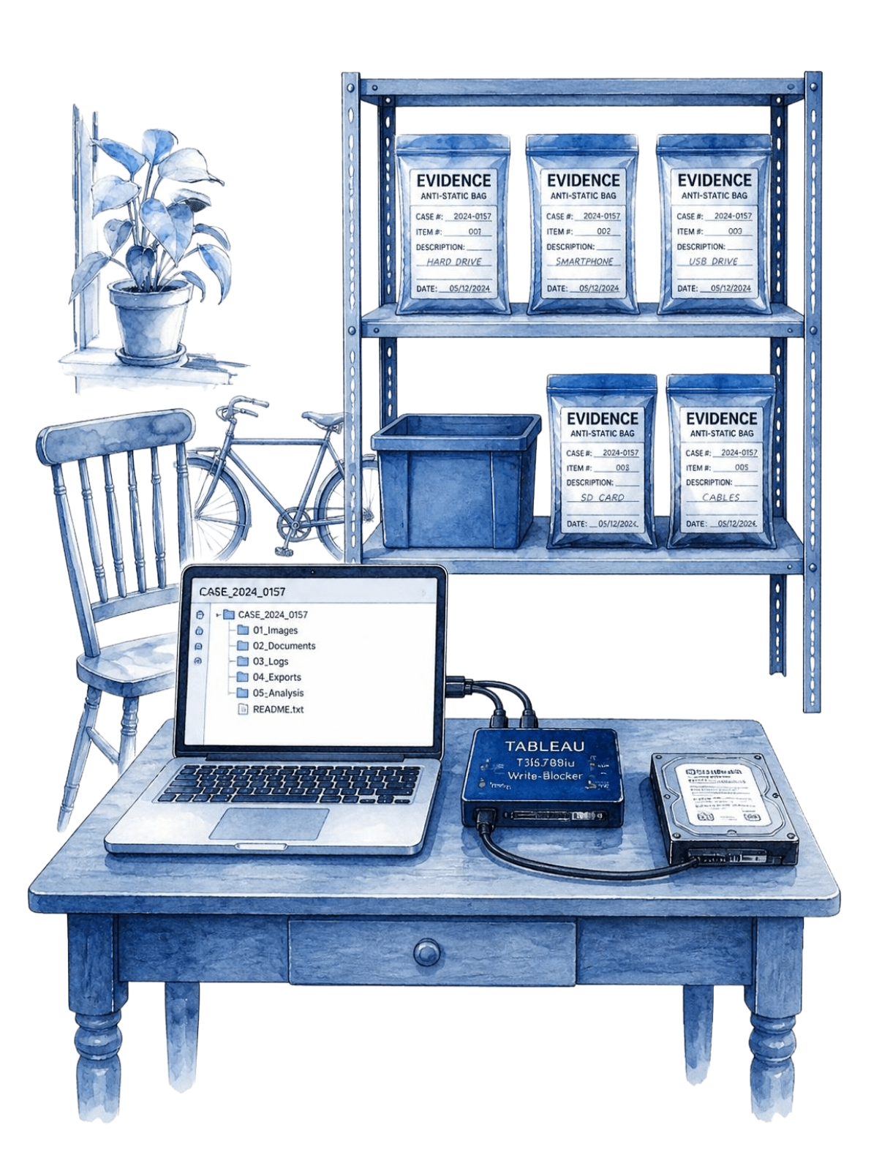
AEGISFORENSICS
AI-Powered Digital Evidence Analyzer
PROJECT TEAM
Mohammed Salman Hyder
160923733227
Mohammed Shahnawaz Khan
160923733192
Mohammed Nuzair Ilyas Siddiq
160923733196
Shaik Muti Ur Rahman
160923733218
digital forensics investigation
Notes:
Introduce the AegisForensics project and present each team member by name and roll number. Establish that the platform is a proposed design combining digital forensics engineering with AI assistance.

Slide 2
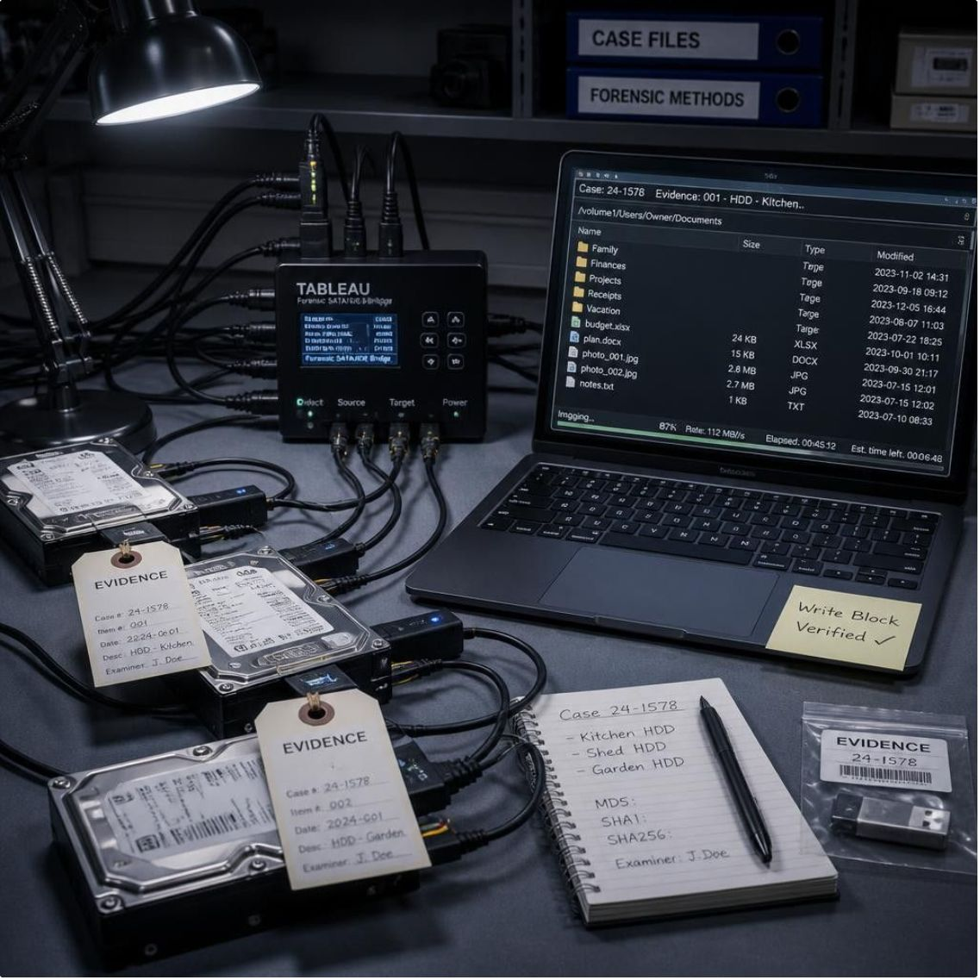
A unified approach to digital evidence
Digital forensics identifies, collects, preserves, examines, and analyses evidence from electronic devices to support legal and technical accountability.
Escalating digital complexity
Proliferating storage formats, volatile states, and manual work demand a more organised, systematic investigation process.
Proposed AI-assisted support
LABORATORY EVIDENCE DISCIPLINE
AegisForensics proposes rigorous forensic data extraction paired with localized machine intelligence to assist investigators.
02
Notes:
Define the foundational role of digital forensics in preserving electronic evidence. Highlight how escalating data volumes create the need for unified, AI-assisted tooling.

Slide 3
Investigations face scattered tools and evidence
Current workflows rely on fragmented, single-purpose utilities across isolated evidence streams.
FRAGMENTATION
TIME BURDEN
CORRELATION & INTEGRITY
Multiple isolated tools
Manual examination lag
Disconnected event records
Disparate programs handle memory dumps, disk images, network traffic, and system logs independently without a shared context.
Manual extraction, pattern cross-referencing, and multi-source report preparation consume critical investigative hours.
Connecting chronological events across differing artifact formats is difficult, while evidence integrity and documentation remain mandatory.
tool fragmentation creates investigator fatigue and reporting delays
03
Notes:
Emphasize the friction modern forensic analysts experience: jumping between separate tools, manual correlation errors, and the challenge of compiling court-ready reports under tight timelines.

Slide 4
Project objectives
AegisForensics defines four key targets to modernise evidence handling while safeguarding investigator oversight.
OBJECTIVE 01
OBJECTIVE 02
OBJECTIVE 03
OBJECTIVE 04
Unify multi-source evidence
Detect suspicious indicators
Preserve strict integrity
Human-controlled reporting
Consolidate disk images, volatile memory, system event logs, packet captures, and mobile extractions under one ingestion engine.
Flag anomalous files, malicious execution signatures, covert persistence mechanisms, and suspicious activity patterns automatically.
Maintain chain-of-custody documentation and cryptographic integrity with automated hashing (MD5, SHA-256) across all assets.
Draft contextual narrative summaries and structured case reports using AI, leaving all final conclusions strictly to human investigators.
04
Notes:
Walk through the four core pillars of the project: unified ingestion, indicator detection, cryptographic chain of custody, and human-in-the-loop report generation.

Slide 5
Literature survey and research gap
STUDY | CORE CONTRIBUTION | FORENSIC SIGNIFICANCE
Solanke & Biasiotti (2022) | Digital evidence mining and efficient investigative pipelines | Highlights performance gains through structured evidence triage
Stoykova & Franke (2023) | Reliability, validation, and documentation standards | Mandates strict verification protocols for court admissibility
Dunsin et al. (2024) | AI and machine learning applications in forensics and incident response | Demonstrates ML efficacy in classifying complex attack payloads
Khalid et al. (2024) | Explainable, human-verifiable artificial intelligence | Emphasizes transparent reasoning over black-box conclusions
Sharma et al. (2025) | ForensicLLM and domain-specific investigative assistance | Validates specialized language models for digital artifact context
Identified Research Gap: Existing tools lack an end-to-end framework integrating multi-evidence ingestion, automated correlation, explainable AI assistance, and defensible audit reporting in one platform.
05
Notes:
Highlight how recent research validates AI assistance in digital forensics, yet leaves a critical gap: existing implementations isolate evidence mining, AI assistance, and reporting into disconnected stages.

Slide 6
One proposed platform, six capabilities
AegisForensics unifies core forensic tasks to reduce tool-switching and manual handoffs.
CORE 01
CORE 02
CORE 03
Evidence Management
Forensic Analysis
Threat Detection
Secure ingestion, custody logging, and metadata indexing across physical and virtual images.
Deep parsing of file systems, memory dumps, network PCAPs, and system activity logs.
Signature matching and anomalous process detection across extracted digital artifacts.
CORE 04
CORE 05
CORE 06
Timeline Analysis
AI-Assisted Summaries
Structured Reporting
Cross-evidence chronological reconstruction mapping user and system events to unified timestamps.
Automated natural language syntheses of complex log bursts and anomalous file activity.
Exportable, court-ready incident documentation with chain-of-custody verification tables.
06
Notes:
Detail the six proposed functional modules. Emphasize that bundling evidence management through reporting directly resolves the workflow fragmentation identified earlier.

Slide 7
Six phases from acquisition to review
1. Acquire
3. Analyse
5. Summarise
Acquire and import evidence.
Analyse files, memory, networks and logs.
Generate AI-assisted summaries and draft narratives.
2. Verify
4. Correlate
6. Review
Extract metadata and calculate hashes.
Correlate findings, build timelines and map activities to threat frameworks.
Investigators validate findings and prepare the final report.
Final interpretation under human control.
07
Notes:
Explain the proposed sequential workflow, from evidence acquisition and hashing through analysis, correlation, AI-assisted summaries and investigator review.

Slide 8
Proposed system architecture
A modular multi-tier architecture separates presentation, service orchestration, forensic processing, and data storage.
User Interface Tier
AI Assistance Service
Interactive dashboard for evidence uploads, investigation management, case workspaces, results, visual timelines, and report review.
Local offline language model processing event clusters for summaries, narrative drafting, contextual assistance, and reporting support.
Backend Orchestration Tier
Database & Secure Storage
Requests, asynchronous job dispatching, API routing, tool communication, and workflow state management.
Investigation information, results, metadata and documentation; relational metadata stores, audit trail logs, hashed image storage, and report artifact repos.
Forensic Processing Engines
Evidence extraction and suspicious indicators; modular extraction engines parsing disk partitions, volatile RAM, network streams, and event logs.
08
Notes:
Walk through the architecture layers from presentation down to database storage. Point out that the AI assistance service operates locally to avoid leaking sensitive case data to external cloud APIs.

Slide 9
Proposed technology stack
Selected technologies balance processing performance, data integrity, and local deployment constraints.
FRONTEND
BACKEND & PIPELINES
DATABASE LAYER
INTELLIGENCE & UI
React.js / Next.js
Python Ecosystem
SQLite / PostgreSQL
Gemma AI Model
Interactive, component-based user interface with rapid server-side rendering and case routing.
Python core runtime leveraging robust forensic parsing libraries, async task workers, and API hooks.
Lightweight zero-config SQLite for single-investigator triage; PostgreSQL for multi-analyst labs.
Local, private parameter model for secure on-premise forensic drafting without cloud leaks.
Styling: Tailwind CSS for responsive forensic layouts.
Visuals: Interactive timeline and log dashboards.
Processing: High-throughput log and artifact parsing.
Storage: Relational tables for hashes and logs.
09
Notes:
Review the chosen tools: React/Next.js for the UI, Python for forensic ingestion, flexible relational databases, and Google's lightweight Gemma model run locally for private inference.

Slide 10
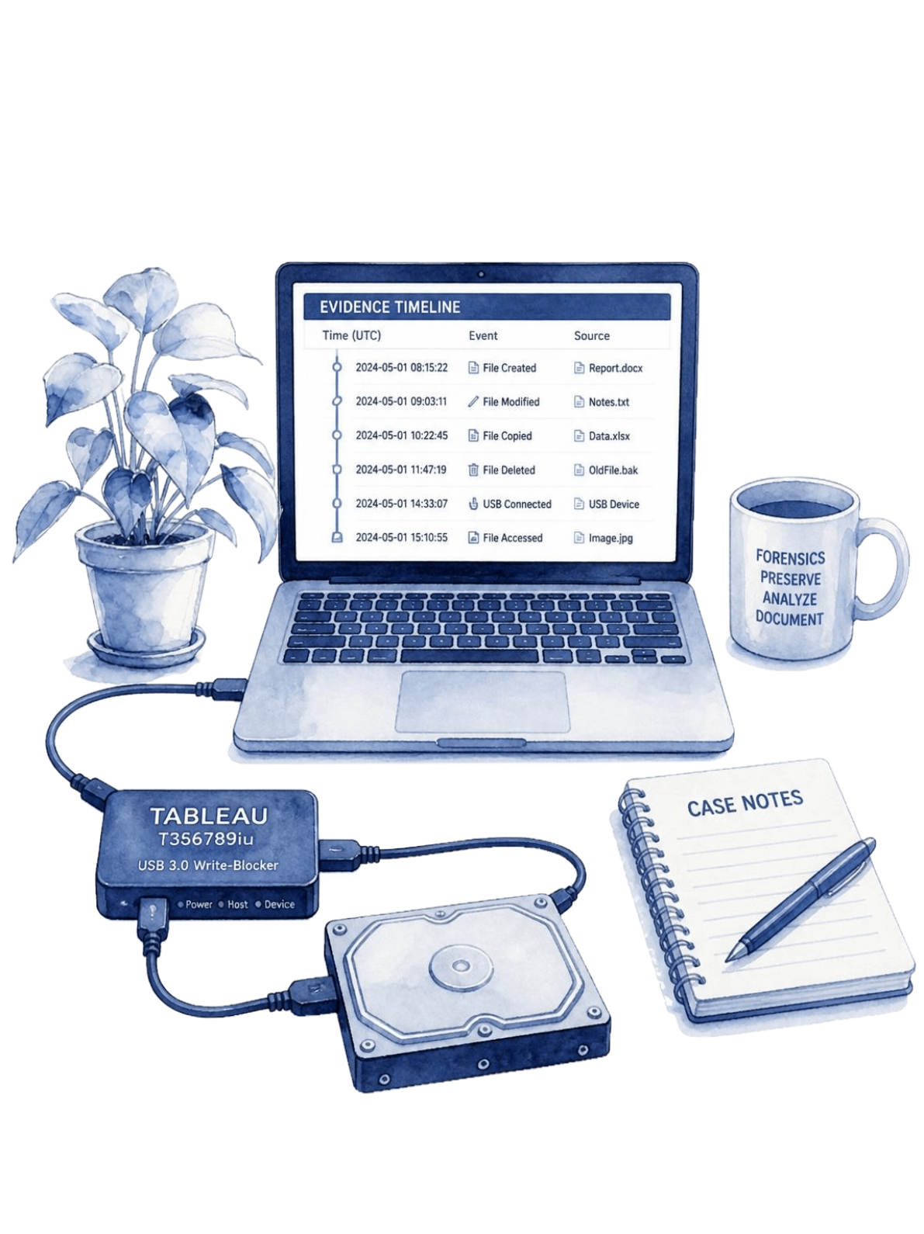
Conclusion and future scope
AegisForensics brings fragmented forensic processes into a cohesive workflow, reducing manual overhead while maintaining strict evidentiary integrity and human accountability.
Expanded Forensic Toolsets
Integrate broader open-source parsers, advanced memory reconstructors, and deep artifact carvers.
Advanced Threat Correlation
Refine AI summaries with graph-based correlation and multi-stage attack mapping.
Mobile & Cloud Extension
Extend support to mobile file systems, cloud audit trails, interactive timeline visualisations, and automated compliance reports.
integrity · validation · human control
10
Notes:
Conclude the presentation. Reiterate that AegisForensics prioritizes human-governed investigation while automating tedious extraction and correlation, and outline future enhancements for cloud and mobile evidence.

